Slide 1

AIRPLANE CRASHES ANALYSIS FROM 1980-2023
By: Ajagunna Ruth Omolara
Date: 24/04/2024

Slide 2
INTRODUCTION
The Airplane Crashes Analysis delve into a comprehensive data spanning from 1980 to 2023, focusing on airplane crashes and fatalities. The objective is to leverage data-driven insights to enhance aviation safety and mitigate risks with the aim of exploring temporal trends, geospatial patterns, operator performance, aircraft analysis, fatality trends, and route analysis to provide valuable recommendations for improving aviation safety worldwide.

Slide 3

DATA SOURCES
This analysis is based on the dataset provided by the Mentorness internship program. This dataset contains comprehensive information on airplane crashes and fatalities spanning from 1980 to 2023. It includes essential details such as crash dates, locations, operators, flight details, aircraft types, and fatality statistics. The Mentorness internship program ensures the quality and reliability of the dataset, making it a credible source for this analysis.

Slide 4
DATA CLEANING AND MANIPULATION
Cleaning Process
Changed Time datatype from Text to Time
Removed Empty
Removed duplicates
Removed unnecessary column cn/ln, flight#
Changed Column Datatype from Text to whole number (Aboard, Aboard Passengers, Aboard Crew, Fatalities, Fatalities Passengers, Fatalities Crew, Ground)
Created New Measures
All these were carried out using the PowerBi Desktop

Slide 5
SUMMARY OF THE ANALYSIS
This analysis of airplane crashes and fatalities from 1980 to 2023 focused on identifying trends and patterns to improve aviation safety. Through thorough data cleaning and analysis, insights were gained in key areas:
Temporal Trends: Understanding incident frequency and severity over time.
Geospatial Patterns: Identifying hotspots and regional incident distributions.
Operator and Aircraft Performance: Evaluating safety records and aircraft involvement.
Fatality Analysis: Investigating passenger and crew fatality trends.
Route Risk Assessment: Identifying routes with higher incident likelihood.
Actionable insights were provided through Interactive PowerBI dashboards and detailed reports

Slide 6
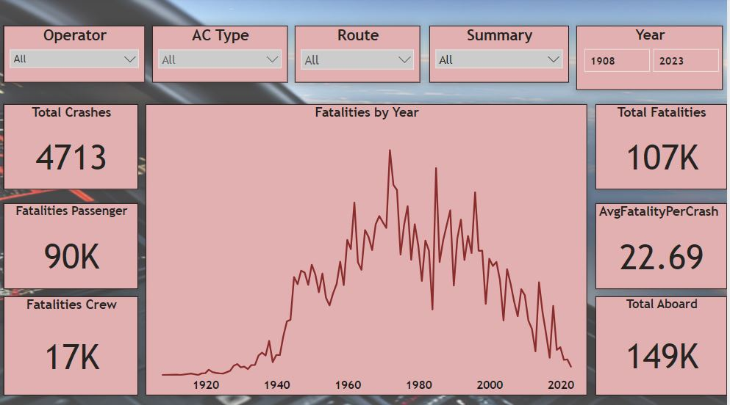
KEY FINDINGS

Slide 7
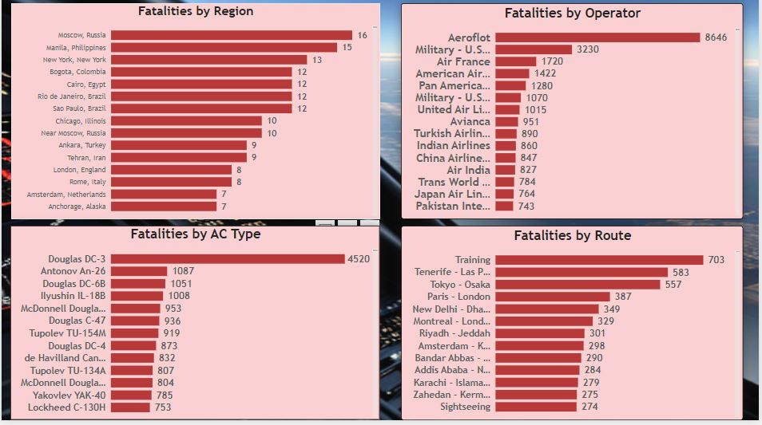
KEY FINDINGS

Slide 8
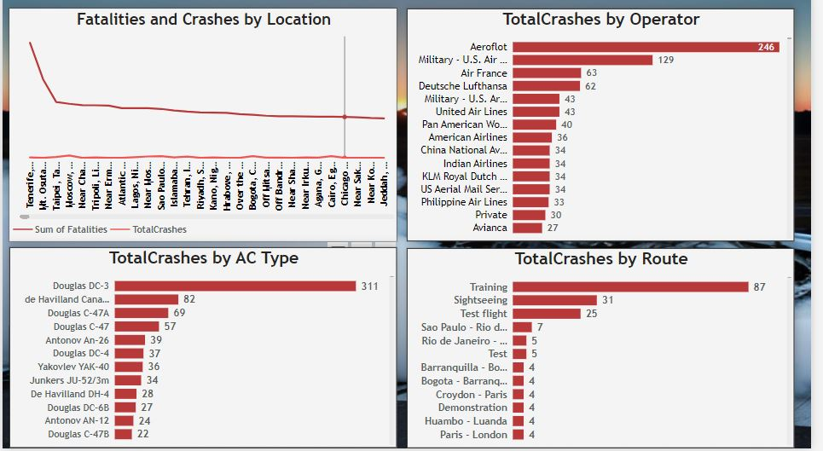
KEY FINDINGS

Slide 9
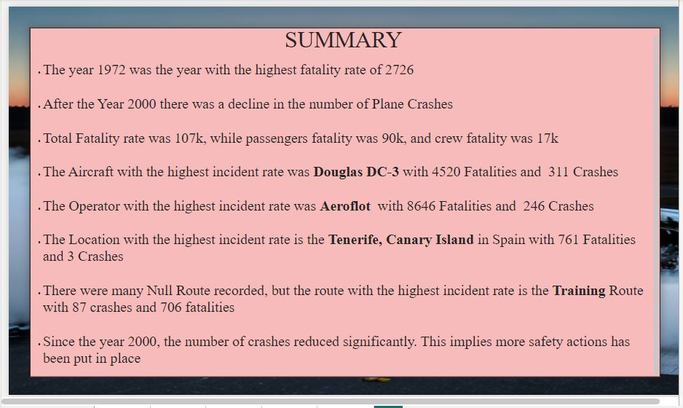
CONCLUSION

